Slide 1
Secure Data Hiding in images using Steganography
CAPSTONE PROJECT
Presented By
Student Name : Krishna D. Samarth
College Name & Department : BE in Industrial Interest of Things (IIOT) at Prof. Ram Meghe Institute of Technology & Research, Badnera Amravati

Slide 2
OUTLINE
Problem Statement
Technology used
Wow factor
End users
Result
Conclusion
Git-hub Link
Future scope

Slide 3
Problem Statement
With the increasing need for secure communication, traditional encryption methods are often susceptible to detection and attacks. Steganography provides a way to hide data within images, making it less likely to be intercepted. This project focuses on implementing a secure method for embedding and extracting confidential data within images while ensuring minimal distortion and maximum security.

Slide 4
Technology used
Programming Language: Python
Libraries/Modules:
OpenCV (for image processing)
NumPy (for handling arrays and pixel manipulation)
Matplotlib (for visualization)
Pillow (for image handling)
Cryptography (for encryption before embedding)
Platform:
VS Code
GitHub

Slide 5
Wow factors
Enhanced Security – The project combines encryption with steganography, making data extraction highly secure.
Minimal Distortion – Ensures that the modified image appears nearly identical to the original, reducing detection risks.
Robust Extraction – The hidden data can be reliably retrieved without significant loss.
Customizable Encryption – Supports different encryption algorithms for added security.
User-Friendly Interface – If you have a GUI, it makes the tool accessible for non-technical users.
Multi-Format Support – Works with various image formats.

Slide 6
End users
Cybersecurity Professionals – To securely transmit sensitive information without detection.
Journalists & Whistleblowers – To share confidential data safely in restricted environments.
Government & Defense Organizations – For secure communication of classified information.
Corporate Sector – To prevent industrial espionage by securely hiding trade secrets.
Researchers & Academicians – For experimenting with data security techniques.
General Users – Individuals who want to protect personal data from unauthorized access.

Slide 7

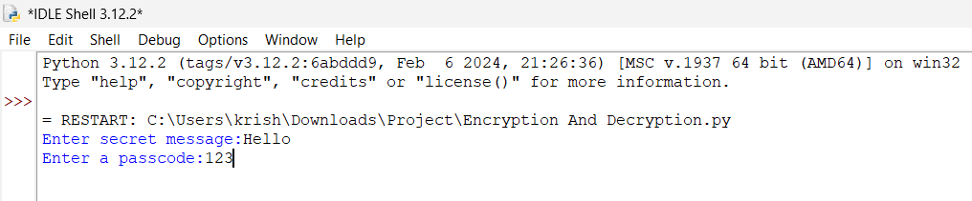
Results

Slide 8
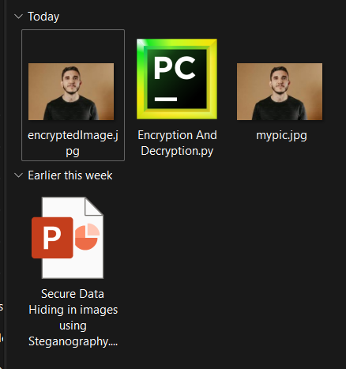
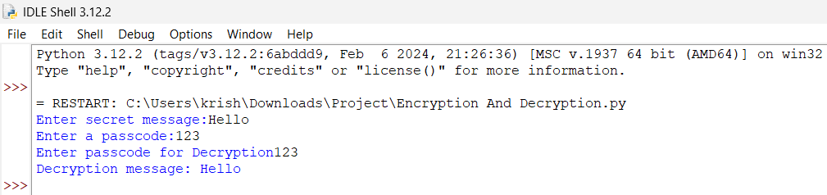
Results

Slide 9
Conclusion
The project successfully demonstrates a secure and efficient method for hiding data within images using steganography. By integrating encryption techniques, it enhances the confidentiality and integrity of hidden messages, reducing the risk of unauthorized access. The results show minimal visual distortion, making the steganographic images undetectable to the human eye. This approach has strong applications in cybersecurity, secure communications, and data protection. Future improvements could include supporting video steganography, increasing embedding capacity, and optimizing processing speed for real-time applications.

Slide 10
GitHub Link
https://github.com/Krishnasamarth/Secure-Data-Hiding-in-Images-Using-Steganography.git

Slide 11
Future scope(optional)
Video Steganography – Extend the concept to hide data in video frames for increased capacity and security.
AI-Based Detection Prevention – Implement AI to analyze images and ensure hidden data is undetectable by steganalysis tools.
Cloud-Based Implementation – Develop an online tool or API for secure data hiding and retrieval.
Increased Embedding Capacity – Optimize the algorithm to store larger amounts of data within images while maintaining quality.
Real-Time Steganography – Improve processing speed to enable real-time hiding and extraction of data.
Multi-Layered Encryption – Enhance security by incorporating multiple encryption techniques before embedding.

Slide 12
THANK YOU

